Slide 1

Unsupervised Learning on Alzheimer’s Disease data with easy-to-understand features
Suong Tran & Quang Nguyen

Slide 2
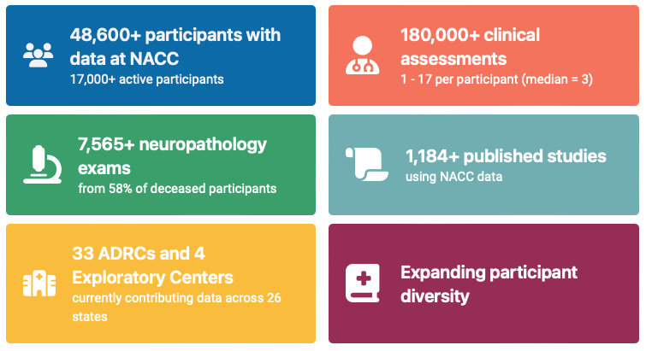
National Alzheimer’s Coordinating Center (NACC) data
Data used in our projects:
- 13689 patients’ data collected since 2005 during standardized annual evaluations conducted at the NIA-funded Alzheimer’s Disease Research Centers (ADRCs) across the country.
- 22 features selected based on literature review and easiness-to-understand for normal people

Slide 3
22 features
1) Demographic Factors:
Age (NACCAGE)
Sex
2) Lifestyle Factors:
BMI
Smoking Habits
3) Health Conditions:
Alcohol-related issues
Diabetes (presence or absence)
Hypertension (History/Presence)
Cardiovascular Health (Heart attack or cardiac arrest)
4) Cognitive Assessment:
CDRSUM (Standard CDR sum of boxes)
DECIN (Informant report of memory decline)
MOSLOW (Observations of slowed movement, expression changes)
Memory (CDR-based assessment)
5) Functional Activities:
SPEECH (Speech impairment)
BILLS (Difficulty in handling bills)
TRAVEL (Difficulty in traveling)
MOFALLS (Frequency of falls)
MOTREM (Rhythmic shaking)

Slide 4
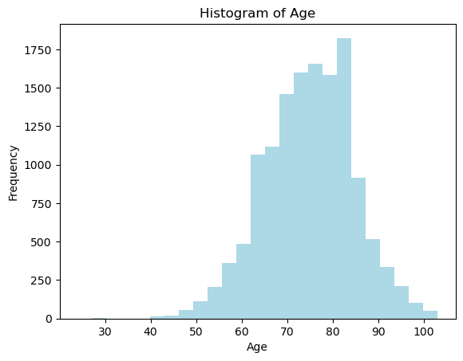
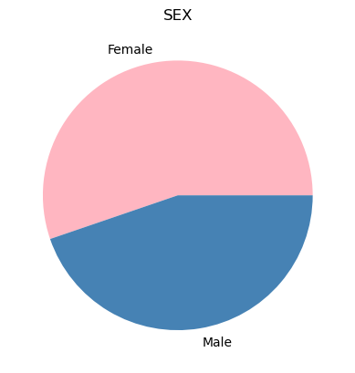
1) Demographic Factors:

Slide 5
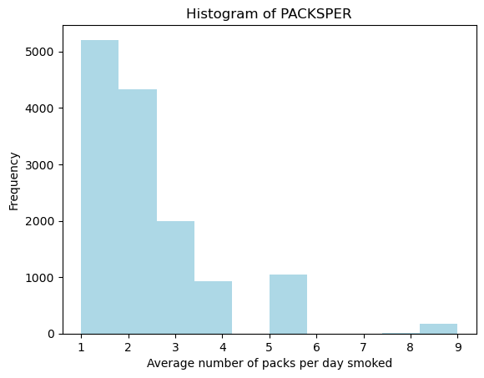
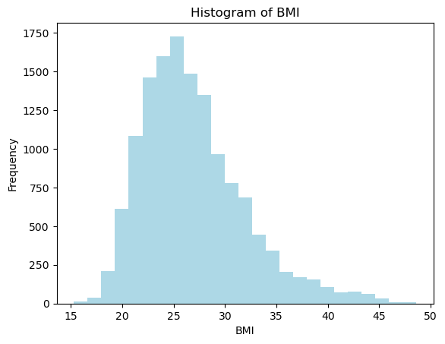
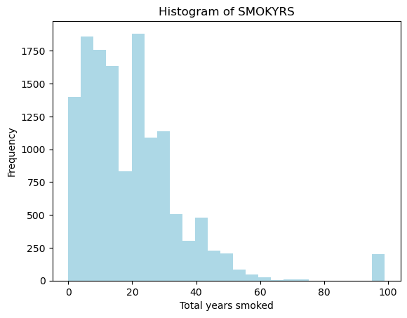
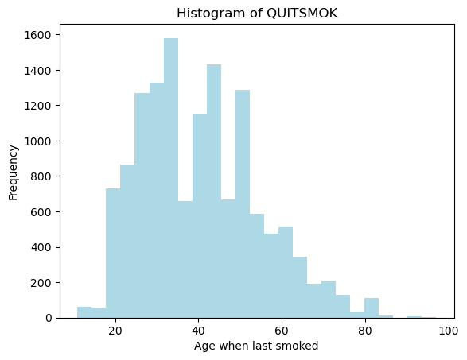
2) Lifestyle Factors:
BMI
Smoking Habits:
TOBAC30: Has the subject smoked within the last 30 days?
TOBAC100: Has the subject smoked more than 100 cigarettes in his/her life?
SMOKYRS: Total years smoked
PACKSPER: Average number of packs per day smoked
QUITSMOK: If subject quit smoking, specify age when last smoked

Slide 6
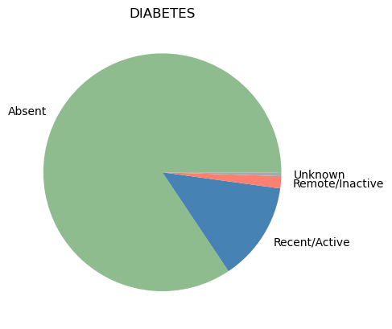
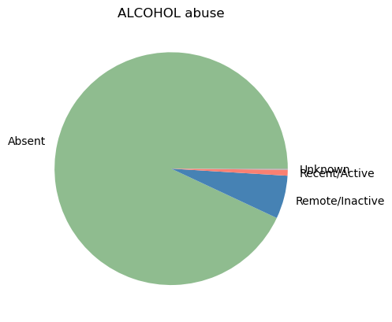
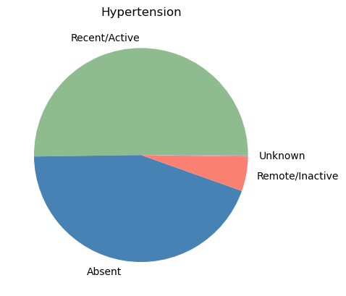
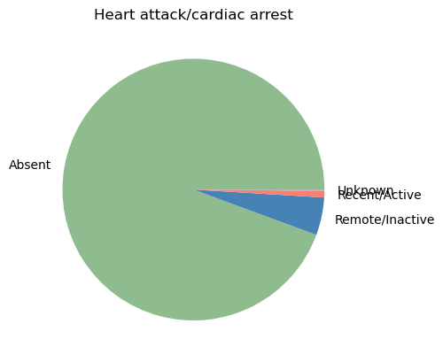
3) Health Conditions:
Alcohol-related issues
Diabetes (presence or absence)
Hypertension (History/Presence)
Cardiovascular Health (Heart attack or cardiac arrest)

Slide 7
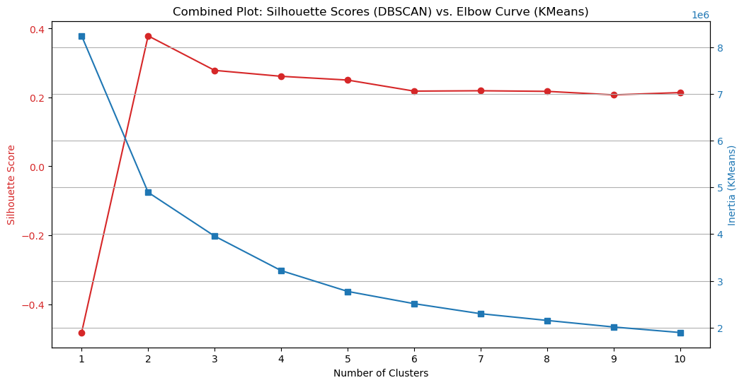
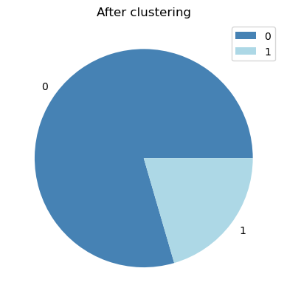
K-means clustering
Notes:
Salmon lightseagreen

Slide 8
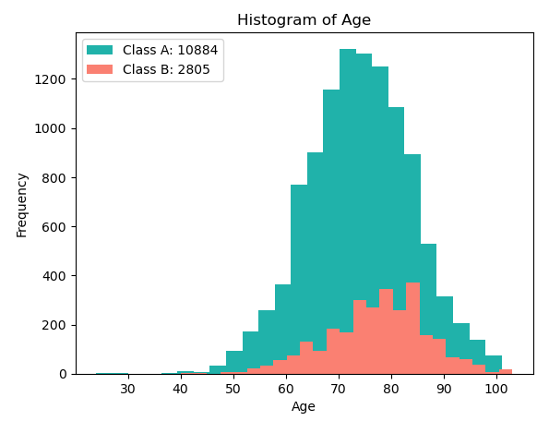
Demographic Factor
Class A: Most participants are 70 years old.
Class B: most people in this group are 80 years old or more.

Slide 9
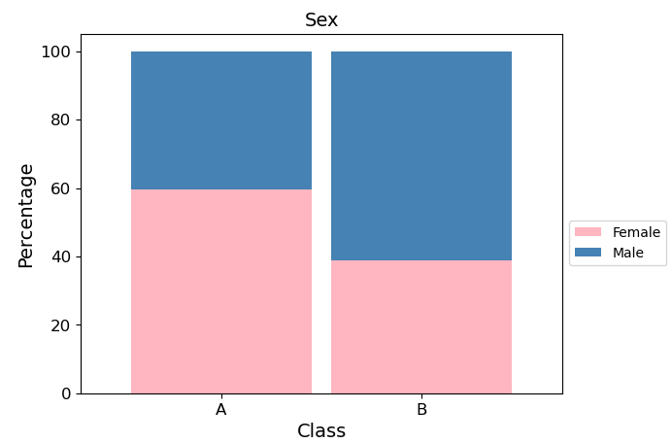
Demographic Factor
Class A: More than half of the participants in this cluster are female.
Class B: There are more males than females in this class.

Slide 10
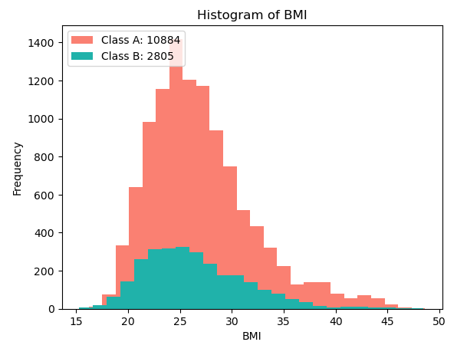
Lifestyle Factor
Class A: the data distribution is roughly normal with a mean of 26.98. The IQR is from 23.4 to 29.6. This suggests that a majority of participants are within the normal range / slightly overweight.
Class B: the mean BMI among 80 year old individuals is approximately 26.49. A BMI of 26.49 falls into the normal/overweight category according to the standard BMI categories.

Slide 11
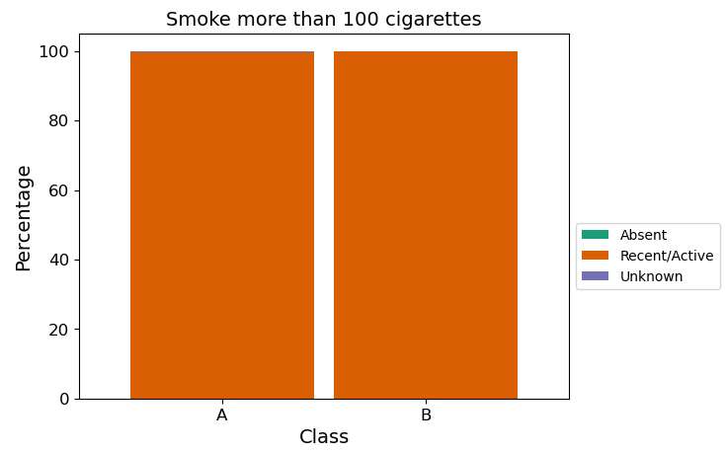
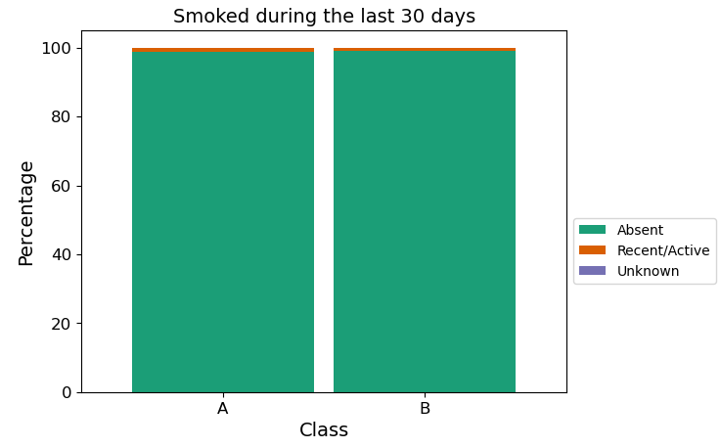
Lifestyle Factor
Almost all participants in both classes didn't smoke in the last 30 days.
Of those who smoke, all participants in both classes did smoke more than 100 cigarettes in their lifetime.

Slide 12
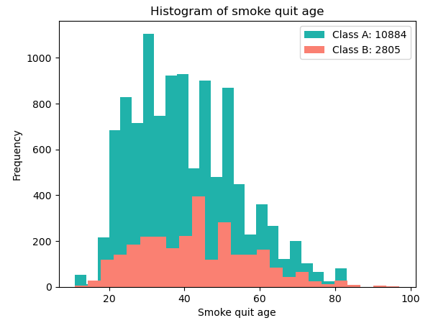
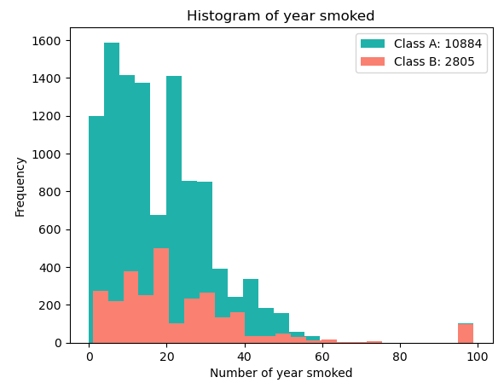
Lifestyle Factor
Class A: the mean number of smoking years among the individuals is approximately 18.24 years. Participants of this cluster quit smoking at various ages, but quitting is most popular at the mid 30s and early 50s.
Class B: the majority of people in this group smoked for about 20 years, and almost all people smoked for about 40 years or less. Also, most people in this group quit smoking at age 40 or less.

Slide 13
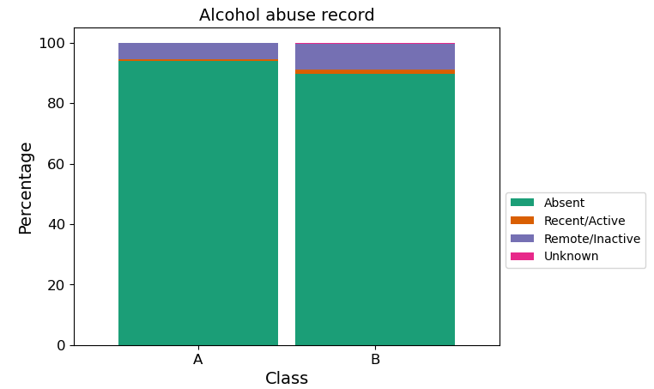
Health Conditions
Most people in both groups didn't have a history of abusing alcohol in the last 12 months or had been inactive. However, there are still a few cases that were reported to have actively/inactively abused alcohol in the last 12 months.

Slide 14
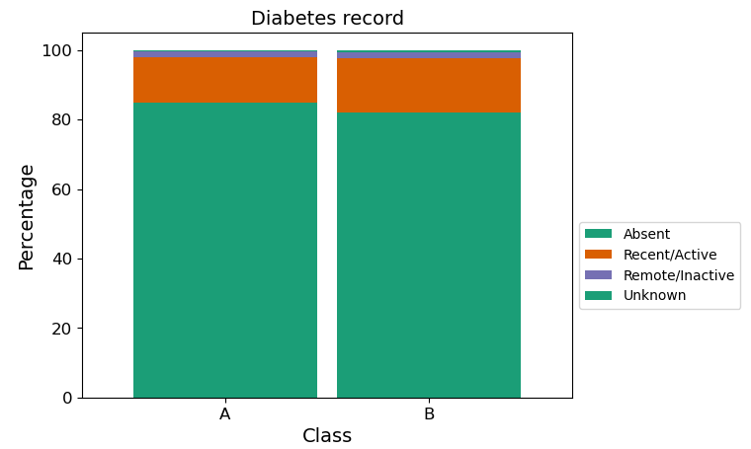
Health Conditions
Almost all participants in both groups did not have diabetes or inactive diabetes with a few cases currently having diabetes.

Slide 15
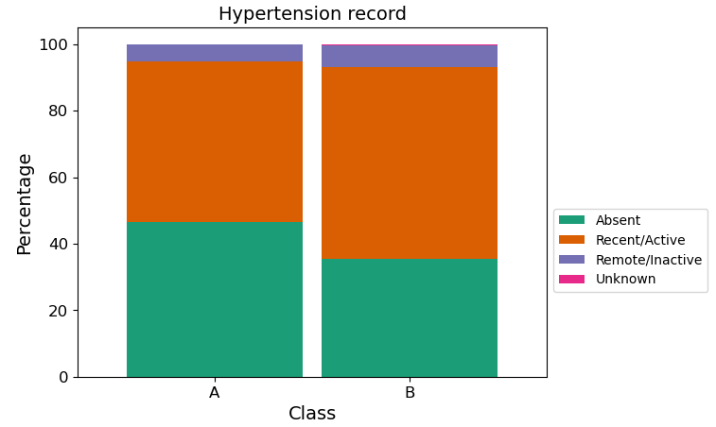
Health Conditions
Half of the participants from class A do not have hypertension, the other half do but this can be explained because of their old age.
The distribution of class B is somewhat similar to class A; however, there are less people without hypertension than class A.

Slide 16
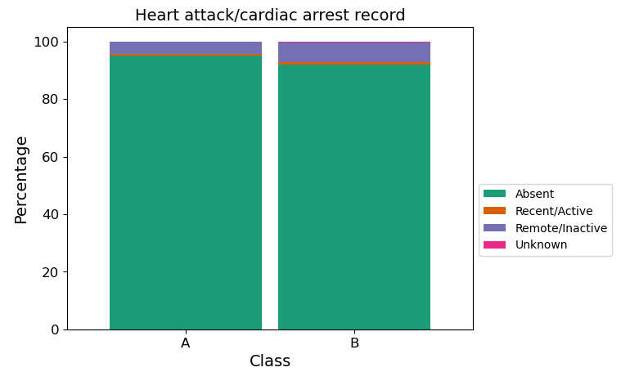
Health Conditions
Almost all participants from both groups did not have heart attack/cardiac arrest or inactive heart attack/cardiac arrest.

Slide 17
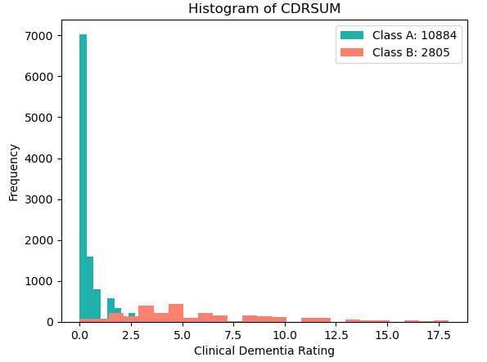
Cognitive Assesment
Class A: a majority of this class is in the normal category in the clinical rating scale.
Class B: more than half of this class have normal or questionable impairment. However, in this class, there are more people with mild to moderate dementia than class A.

Slide 18
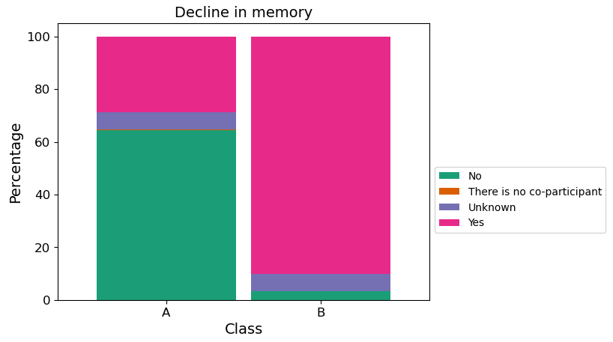
Cognitive Assesment
Class A: a majority of this group wasn't reported to have a decline in memory. However, there are still cases were reported to have a decline in memory or unknown.
Class B: almost all participants in this cluster are reported to have a decline in memory.

Slide 19
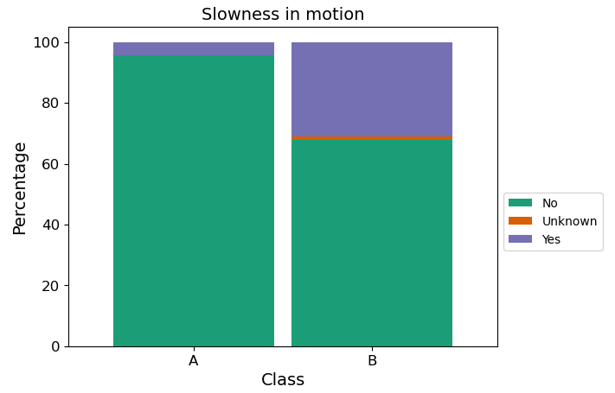
Cognitive Assesment
Class A: almost all participants were reported to have no meaningful changes in motor function.
Class B: many participants were not reported to experience slowness. However, there is a significant increase in reported cases of experienced slowness.

Slide 20
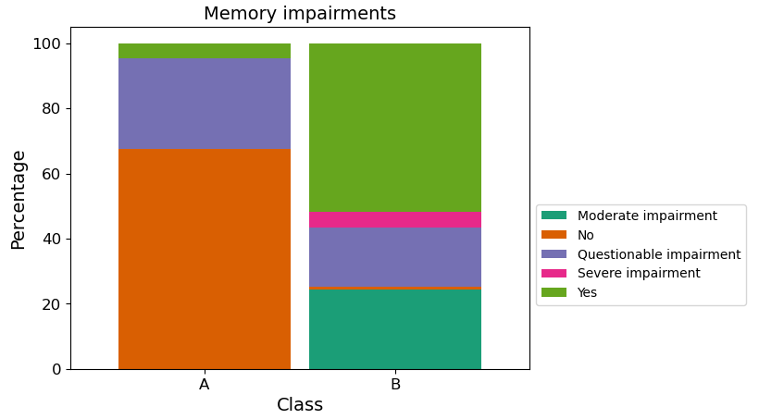
Cognitive Assesment
Class A: a majority of this group has no memory impairment. However, there are still cases that have questionable impairment and a few number of cases have mild/moderate impairment.
Class B: most participants in this group were reported to have some type of memory impairment, with almost all participants reported to have questionable/mild/moderate/severe impairment.

Slide 21
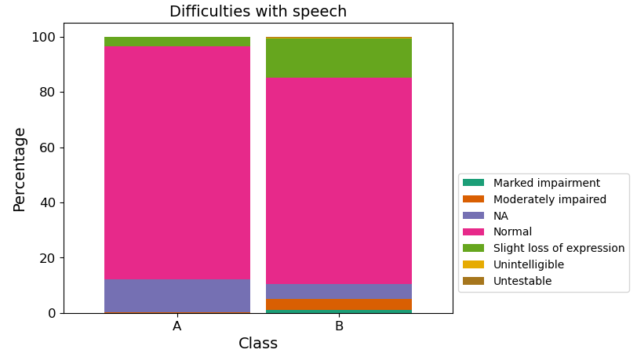
Functional Activities
Class A: no severe cases were reported, a majority of participants have normal speech and a few cases were reported to have slight loss of expression, diction, and/or volume; or not available.
Class B: more people were reported to have a slight loss of expression, diction, and/or volume than class 0.

Slide 22
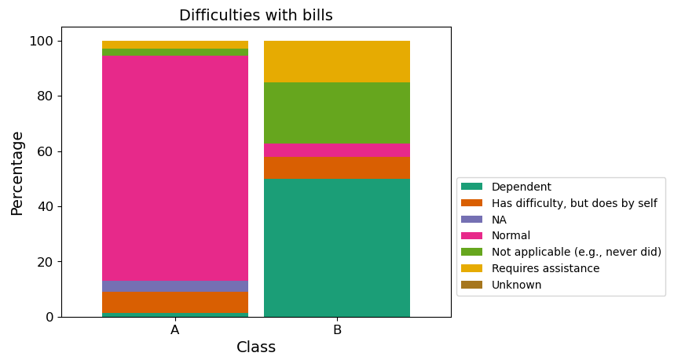
Functional Activities
Class A: a majority of this group encountered no difficulties in writing checks, paying bills, or balancing a checkbook. However, there are still a few cases that encounter some difficulties but do it by themselves.
Class B: most people in this group encountered difficulties at some levels when writing checks, paying bills, or balancing a checkbook.

Slide 23
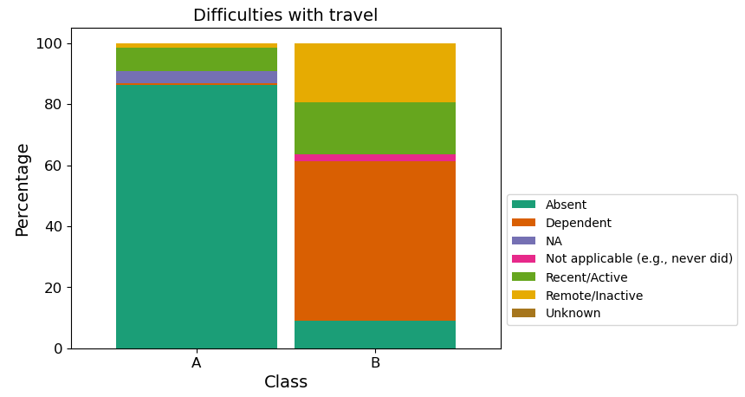
Functional Activities
Class A: a majority of this group encountered no difficulties in traveling out of the neighborhood, driving, or arranging to take public transportation. However, there are still a few cases that encounter some difficulties but do by themselves.
Class B: most people in this group encountered difficulties at some levels when traveling out of the neighborhood, driving, or arranging to take public transportation.

Slide 24
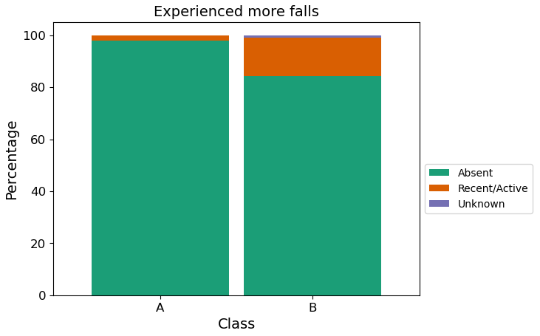
Functional Activities
Most people in both groups weren't reported to fall more; however, more people experienced falls in group B than in group A.

Slide 25
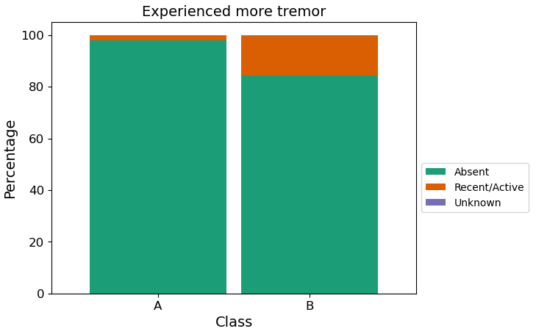
Functional Activities
Most people in both groups weren't reported to have more tremors; however, more people experienced tremors in group B than in group A.

Slide 26
General conclusion
Class A appears to consist of individuals who are generally healthier, with fewer reported impairments in memory, motor function, speech, and activities of daily living.
Class B, on the other hand, seems to have a higher prevalence of memory decline, motor function issues, falls, tremors, and difficulties with daily activities.
Both groups have similar patterns in terms of smoking habits, alcohol abuse, diabetes, and heart health, but class B tends to have slightly worse health outcomes overall.
Age distribution differs, with class B consisting of older individuals on average.
There's also a slight difference in sex distribution, with class B having more males compared to class A.

Slide 27
Limitation?
Human-involved
No validation
Future Goal?
STILL COOL DATA → Interactive dashboard
If possible, based on clustered data → supervised learning model
then predict % of chance having AD (but CANNOT take this seriously)
Question?
Notes:
Salmon lightseagreen

